Slide 1
Towards Open-Source MRI Data: Defacing and Sharpness Estimation
Emma Hokken | AI Master’s Thesis | 30 June 2021
Notes:
Welcome to the presentation of my Master's thesis, in lieu of a defense. I'll be presenting my master's thesis titled Towards Open-Source MRI data: Defacing and Sharpness estimation.

Slide 2
Outline
Objectives
Research Questions
Magnetic Resonance Imaging and reconstruction
Defacing
Sharpness Estimation
Conclusion
Notes:
Just a quick outline of what's ahead. First I'll be providing some introductory background information on MRI reconstruction, after which I'll discuss the objectives and research questions of this project. Because this project comes in two parts, I'll be discussing the methodology, results and discussions of the defacing first, after which the methodology, results, and discussion of the sharpness estimation will follow.

Slide 3
Objectives
Deliver a new anonymous dataset to be used for accelerated MRI reconstruction
Develop a structural, quantitative method of evaluating the content-wise quality of reconstructed MR images
Notes:
As mentioned before, this study comes in two parts. The first objective is to release an anonymous dataset that can be used in research towards accelerated MRI reconstruction. Datasets containing raw-kspace data are not widely available and as Deep Learning needs a lot of data, this could provide valuable data to the research community.
A second objective is to develop a quantitative evaluation method that assesses the reconstruction quality of MR images. This will be accomplished by estimating the sharpness across tissue boundary. Right now, no such method is available, as most networks use SSIM or RMSE as their loss function and only evaluation method. Thus, a method that evaluates the content-wise quality could be a valuable addition.

Slide 4
Research Questions
How can MRI data be defaced without compromising the raw data?
Is it possible to create a structural, quantitative method of assessing content-wise reconstruction quality by estimating the sharpness of tissue boundaries?
Notes:
These objectives translate into the following Research Questions.
How can MRI data be defaced without compromising the raw data? - As it is important for Acelerated MRI reconstruction that the nature of the k-space data does not differ from non-defaced MRI scans.
And
Is it possible to create a structural, quantitative method of assessing content-wise reconstruction quality by estimating the sharpness of tissue boundaries?

Slide 5
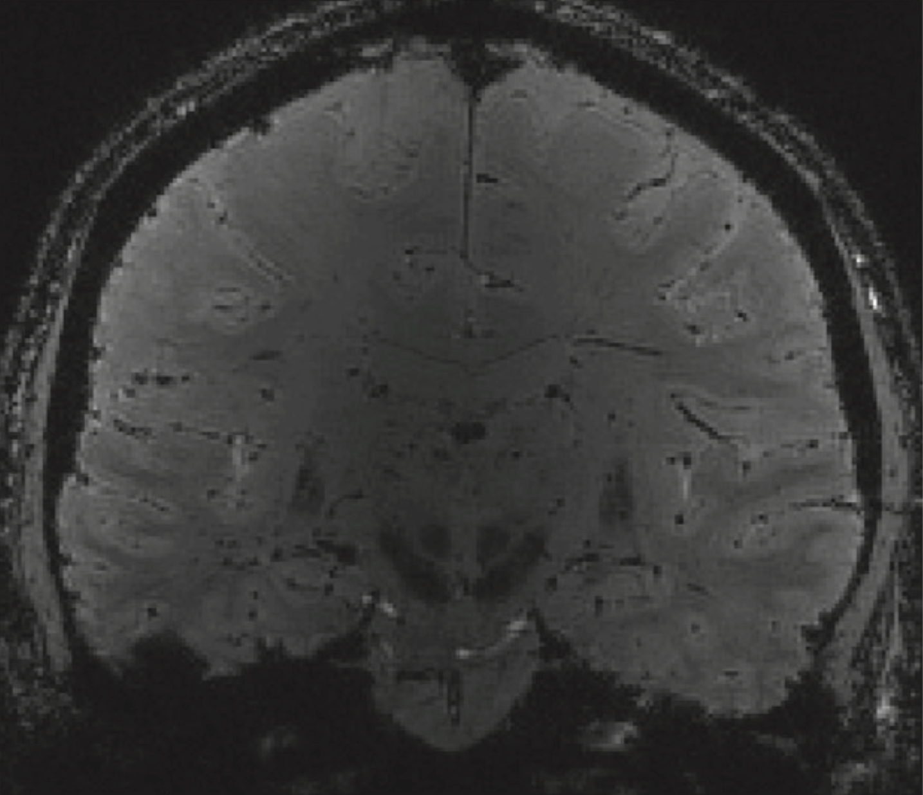
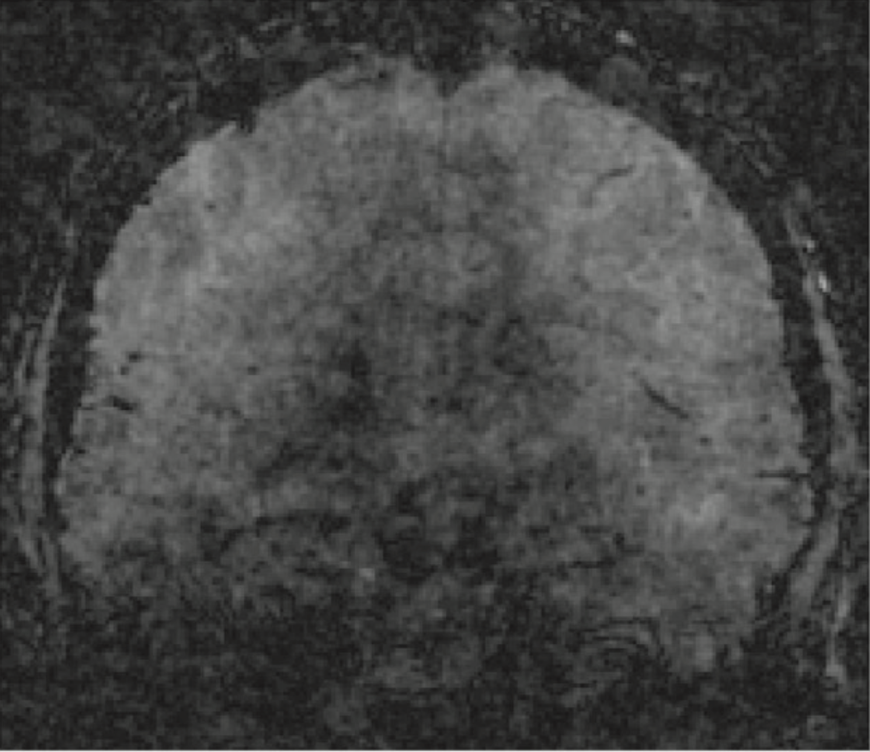
MRI reconstruction
Uses magnetism and radio frequency pulses to create image of body
Long acquisition times
Possible to sub-sample k-space
Increases Signal to Noise ratio
Solution: Accelerated MRI reconstruction
Dealiasing of accelerated MRI scan
GRAPPA, SENSE, Deep Learning Techniques
Notes:
MRI is a method that used magnetism and radio frequency pulses to image the body. It is used in a wide variety of clinical and research settings. Recent increases in image quality have come at the cost of acquisition time.
It is possible to speed up the acquisition time of MRI by subsampling the k-space. This means only reading every nth line of k-space. However, this creates a noisy image full of aliasing or wrap-around and increases the SNR.
A solution to this is Accelerated MRI reconstruction, which is the dealiasing of this noisy image. A wide variety of methods for this are available, of which the focus today will lie on Deep Learning-based reconstruction methods.

Slide 6
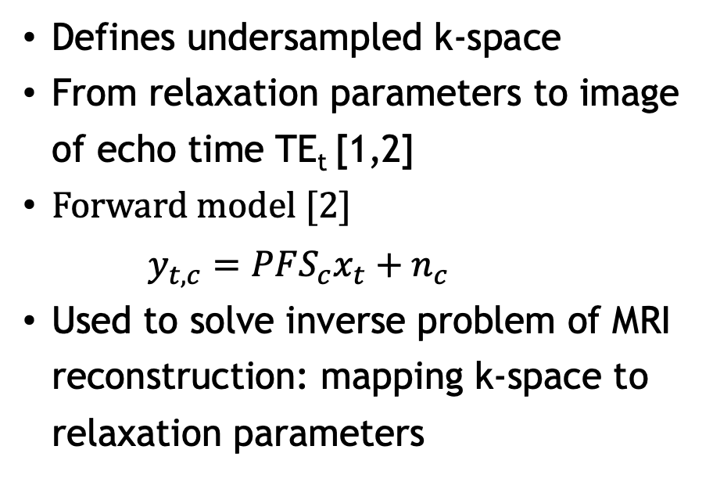
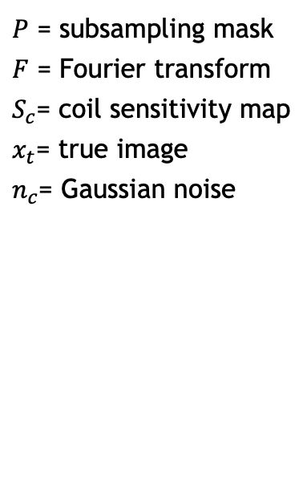
Forward model
Defines undersampled k-space
From relaxation parameters to image of echo time TE_{t} [1,2]
Forward model [2]
$y_{t,c}=PFS_{c}x_{t}+n_{c}$
Used to solve inverse problem of MRI reconstruction: mapping k-space to relaxation parameters
$P$ = subsampling mask
$F$ = Fourier transform
$S_{c}$= coil sensitivity map
$x_{t}$= true image
$n_{c}$= Gaussian noise
Notes:
The basis of MRI lies in the forward model which is used to subsample a fully sampled MR image. This way, the target image is known and can be used to train the reconstruction model/

Slide 7
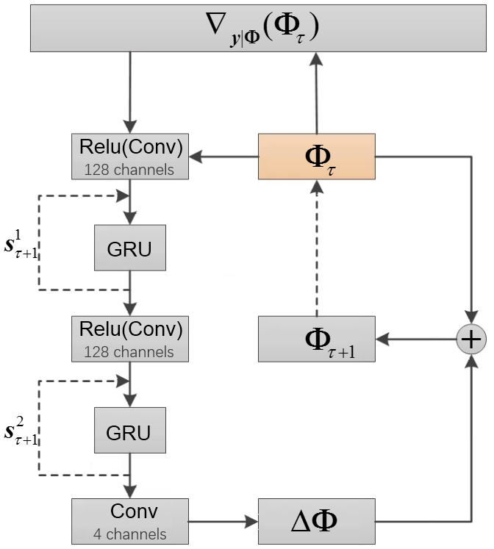
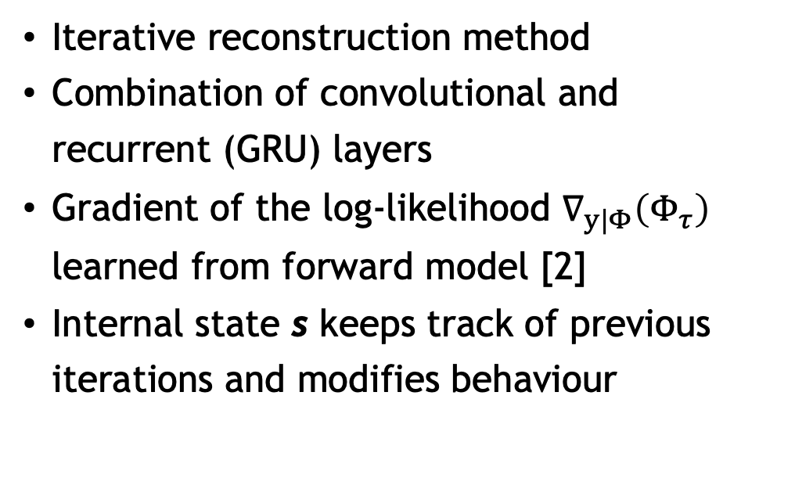
Recurrent Inference Machine (RIM)
Iterative reconstruction method
Combination of convolutional and recurrent (GRU) layers
Gradient of the log-likelihood $∇_{y|Φ}\left(Φ_{τ}\right)$ learned from forward model [2]
Internal state s keeps track of previous iterations and modifies behaviour
Notes:
The Recurrent Inference Machine is an iterative reconstruction method, updating the image with each iteration. It uses a combination of convolutional layers and recurrent lyaters, namely Gated Recurrent Units.
It learns the gradient of the log-likelyhood as derived from the forward model and uses an internal state \textbf{\textit{s}} to keep track of iterations and to modify the behaviour of the method.

Slide 8
AHEAD dataset
Amsterdam Ultra-high field adult lifespan database [3]
105 7T whole-brain structural MRI scans
Ages 18-80
Multi-echo magnetisation-prepared rapid gradient echo (MP2RAGEME) sequence [4]
T1, T2, R1, R2*, Quantitative Susceptibility Mapping (QSM) images
Acceleration factor 2, GRAPPA reconstructed
Notes:
The dataset that will be used for both defacing and sharpness estimation is the Amsterdam Ultra-high field adult lifespan database dataset. It consisted of 105 images from a variety of ages. It was created using the MP2RAGEME sequence which resulted in multiple images, of which the complex coil images for all echo times will be used in the defacing and the R2* maps will be used in the sharpness estimation

Slide 9
Defacing
Removal of all facial features, leaving the brain and skull intact
Two methods
Freesurfer: ready-to-use defacing tool, trained on T1 volumes [5]
Calculate face and brain probability
Remove face, leave in brain
Dilating of brain mask
Expand brain mask
Kernel size: 5x5x5, 10 iterations
Gaussian smoothing to facilitate alpha blend
Notes:
Defacing involves the removal of facial regions while leaving the brain and most of the skull intact. Two methods were explored, the ready-made Freesurfer defacing tool and a dilation algorithm. The Freesurfer defacing worked by determining the pixel-wise probabilty that a pixel was brain or face, dilated the brain pixels and removed the pixels with a non-zero probability of belonging to the face. This method was trained on T1 images.
The dilation algorithm expanded the brain mask, as can be seen in the image on the right and applied this dilated mask to the complex coil image. Dilation was perfomed using a 5x5x5 kernel for 10 iterations.
The edges of the removed faced were smoothed using a Gaussian filter to facilitate an alpha blend.

Slide 10
Adding Gaussian background noise
Defacing using dilation removes background, thus noise
Newly generated Gaussian noise added to background
Select ring from last slice of k-space
Width: 27 pixels
Calculate standard deviation
Generate Gaussian noise and add to defaced image
Gaussian smoothing to facilitate alpha blend
Notes:
MRI images are noisy, as is their background. The dilation defacing removed the background, thus changing the inherent properties of the image. TO remedy this, Gaussian noise was simulated and added to the background. For this, a ring was selected from the last slice of k-space. The outside of this slice was theorized to not contain any signal, and thus only noise. The standard deviation was calculated from this ring and from that, new Gaussian noise was generated. The edges of this noise were smoothed to again facilitate a smooth transition between the defaced image and the added noise.

Slide 11
Results: Freesurfer defacing
Insufficient defacing for some subjects
Silhouette of face remained
Removed part of the brain → corrected with use of brain mask
Notes:
The Freesurfer defacing proved insufficient for most sobjects, removing the inner parts of the face but leaving a silhouette behind, thus making facial reconstruction possible. The method also removed parts of the brain which were corrected by use of the brain mask.

Slide 12
Results: Dilation
Sufficient defacing in all planes
Eyes partially remain
Generalises well to all subjects
Notes:
Because the Freesurfer defacing proved insufficient, we turned to another method: Dilation. This proved to remove the face nicely, as can be seen for all planes here. The eyes partially remain but this is not enough for identification.
This generalises well for all subjects, so the same kernel size and number of iterations sufice.

Slide 13
Results: Addition of Gaussian noise
Comparison between original and defaced background noise
Overestimation of added Gaussian noise
Mean difference: 47.5%
Similar for all echo times
Notes:
To compare noise, background noise was sampled from both the original and defaced image and the standard deviation was compared. This showeed an overestimation of 47.5\%.
This was similar for all echo times.

Slide 14
Discussion: Defacing
Defacing using Freesurfer proved insufficient
Likely due to noisy T1 background
Defacing using dilation of the brain mask proved sufficient
Same kernel size and number of dilation iterations sufficed for all subjects
Overestimation of added noise in background
Potential cause: spatial variance caused by g-factor in GRAPPA reconstruction
Notes:
Freesurfer defacing proved insufficient, most likely due to the more noisy background of the available T1 images. Dilation showed to be a valid defacing method, but the generated background noise was overestimated, changing the inherent properties of the image somehwat.
This overestimation of noise could be caused by the spatial variance in noise due to the g-factor present in GRAPPA reconstructed images. The unreconstructed images could be used in future work.

Slide 15
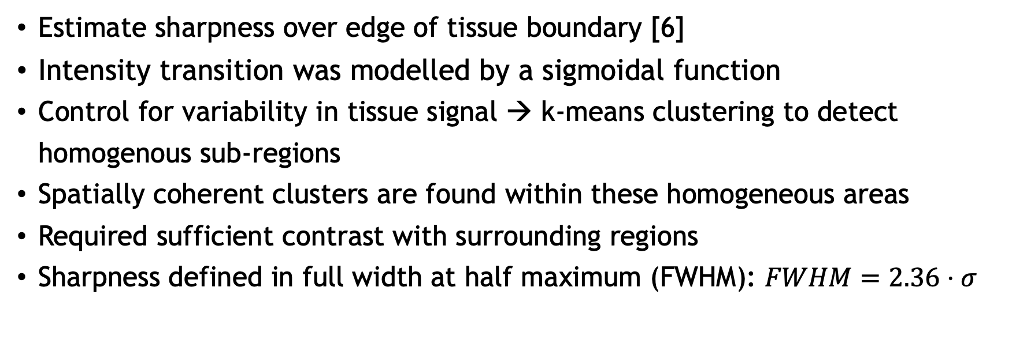
Sharpness Estimation
Estimate sharpness over edge of tissue boundary [6]
Intensity transition was modelled by a sigmoidal function
Control for variability in tissue signal → k-means clustering to detect homogenous sub-regions
Spatially coherent clusters are found within these homogeneous areas
Required sufficient contrast with surrounding regions
Sharpness defined in full width at half maximum (FWHM): $FWHM=2.36⋅σ$
Notes:
The sharpness method is a re-purposed version of the method created by Pilou Bazin, originally for assessing motion correction improvement.
Sharpness is defined as the edge width of a specific Region of Interest or ROI where sharpness is defined along the transition boundary to the surrounding tissue. This intensity transition was modelled by using a sigmoidal function. The actual sharpness estimation over the edge of the ROI was fitted to signal values which allowed for an accurate estimation of the edge width and the corresponding uncertainty, given the amount of noise in the data. The eventual sharpness was measured in physical distance. To control for variability in tissue signal, k-means clustering was used to select homogenious regions over which to calculate sharpness. Within these homenegeous ares, spatially coherent clusters are selected by another k-means clustering. Calculations were also restricted to clusters where sufficient contrast was present with the surrounding tissue.
FWHM measures smoothness, so lower FWHM indicates sharer image

Slide 16
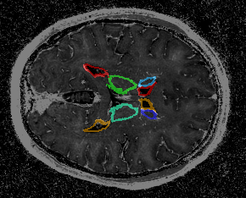
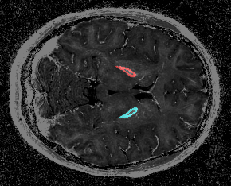
Sharpness Estimation
RIM reconstructed R2* maps from AHEAD dataset
9 subjects
Acceleration factors
3, 6, 9, 12
Four regions explored
Globus pallidus, striatum, thalamus, ventricles
Notes:
Sharpness estimation was performed on RIM reconstructed R2* maps from the AHEAD dataset. Four regions were explored, the globus pallidus, striatum, thalamus, ventricles

Slide 17
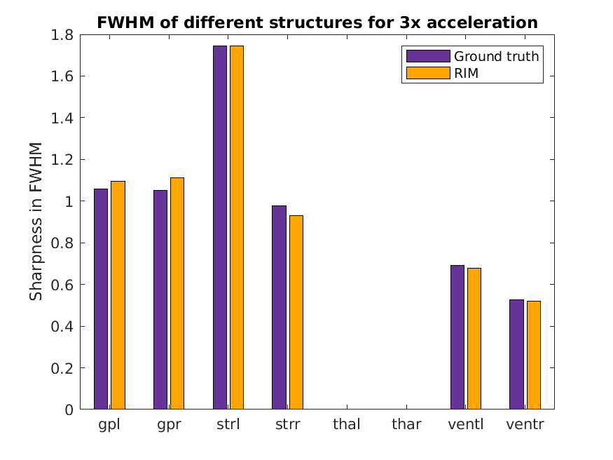
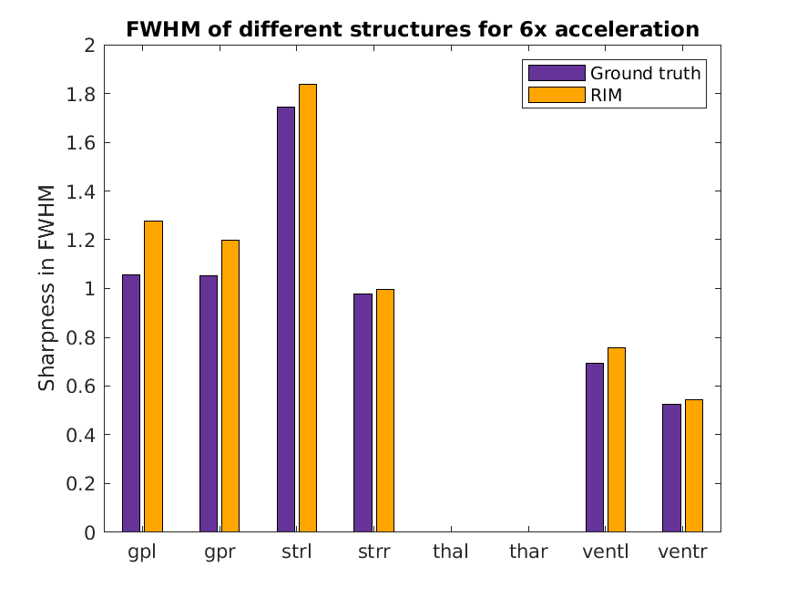
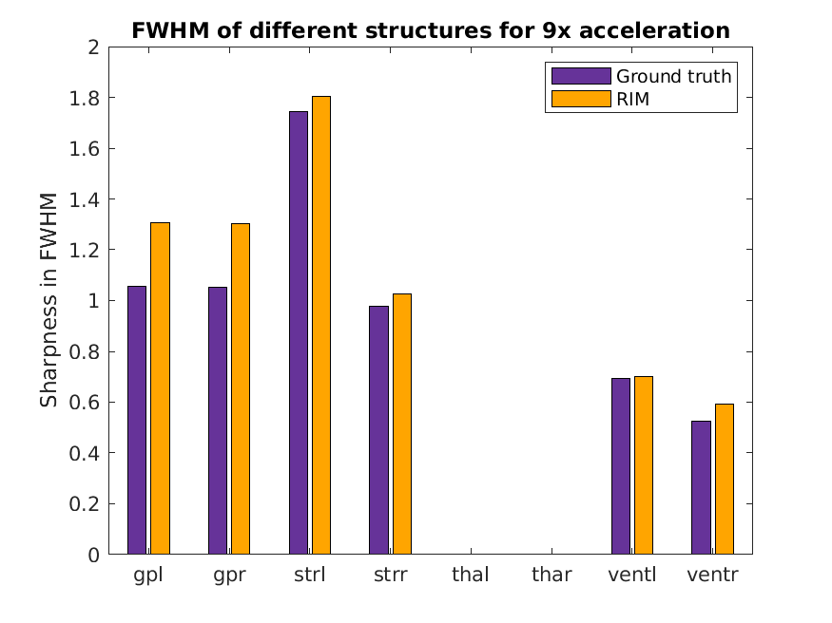
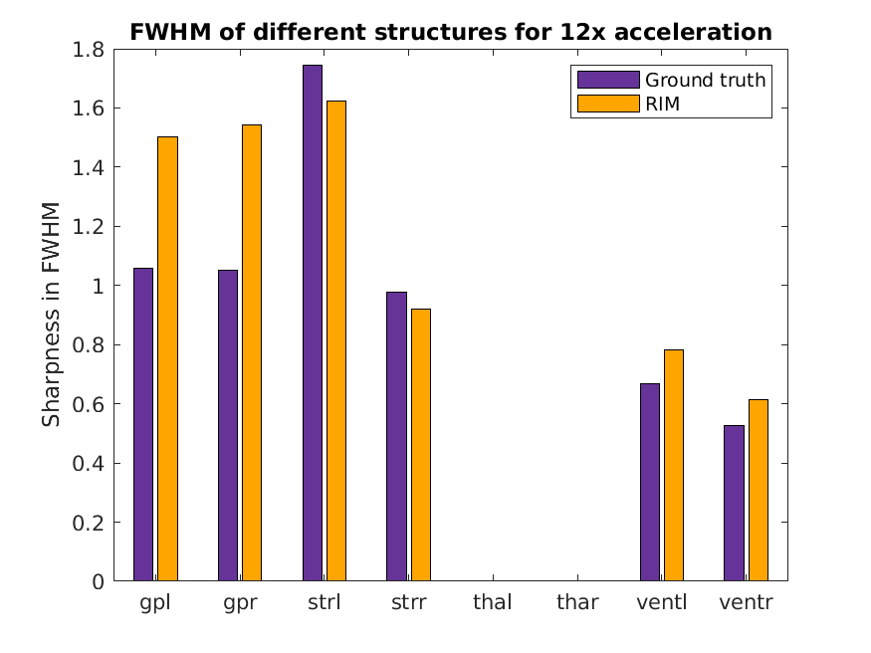
Results: Sharpness Estimation
Increase in FWHM with subsequent acceleration factors
Thalamus (thal and thar) insufficient contrast for estimation
Notes:
The images to the right show a difference between the ground truth and the reconstruthed images. They further how an increase of FWHM for subsequent acceleration factors.
The thalamus is left blank because method lacked contrast.

Slide 18
Results: Sharpness estimation
Upwards trend in FWHM in most regions, excluding ventricles
Not much difference between GRAPPA reconstructed and 3x accelerated
Trend can be seen in all regions combined
Notes:
In order to use this method as an evaluation tool, it must be able to detect a difference in quality of reconstructed images. For this, 3x accelerated and 12x accelerated images were compared, as 12x accelerated images are known to be less sharp than 3x accelerated images.
Most regions show an upwards trend in FWHM, except the ventricles.
Not much difference between GRAPPA reconstructed and 3x accelerated data.
An upwards trend in FWHM can be seen for all regions combined as well. However, first and fourth quartile are still quite similar, so statistical analysis was needed

Slide 19
Results: Trend analysis
Compare FWHM from 3x accelerated data with that of 12x accelerated data
Combine FWHM from left and right hemisphere in one averaged number
Data was normally distributed and showed equal variance
Paired t-test showed significant difference between samples
p = 0.029
Notes:
In the trend analysis, the FWHM for 3x with 12x accelerated images was compared. Results from the left and right hemisphere were combined, and a paired t-test showed a significant differnce with a p-value of 0.029.

Slide 20
Discussion: Sharpness estimation
Method shows distinguished results between subsequent acceleration factors
Requires sufficient contrast with surrounding regions
Iron-rich globus pallidus shows steady increase
Ventricles show lack of contrast
Clustering approach needed to be fixed for regions
Could decrease performance as suboptimal regions are selected for higher acceleration factors
Notes:
The method was shown to be able to distinguish between reconstruction quality, showing that it is a valid indicator for image quality. Does require sufficient contrast with surrounding regions, something which is visible in the iron-rich globus pallidus, which shows large conrtast on R2* maps,. This would also the downwards trend visible in the ventricles, as this area shows less contrast.
However, in order to compare subsequent acceleration factors, the clustering approach needed to be fixed so the ground truth would return the same value each run. This could mean sub-optimal regions are selected.

Slide 21
Conclusion
Defacing
Defacing using dilation was successful
Overestimation of additive Gaussian noise in background
Release both versions of data, with and without added noise
Sharpness estimation
Method was able to estimate sharpness of reconstructed images
Able to detect significant difference between 3x and 12x accelerated data
Needs sufficient contrast, not always present in reconstructed R2* maps
Notes:
To conclude. The defacing using dilation proved a valid method. The generated background noise was shown to be overestimated. The current solution for this is to release both the data with added noise and those without, leaving the choice up to the researched which one to train their model on.
With regards to sharpness estimation: the method was able to detect different reconstruction qualities for different acceleration factors, showing that it is a valid evaluation method for assessing reconstruction quality. The method does require sufficient contrrast, which is not always present in R2* maps.

Slide 22
Acknowledgements
Supervisors
Chaoping Zhang (Amsterdam UMC)
Matthan Caan (Amsterdam UMC)
Xiantong Zhen (University of Amsterdam)
Examiner
Pascal Mettes
Notes:
I would like to thank Chaoping, Matthan, and Xiantong for their excellent supervision during this project, and Pascal Mettes for being the examiner on this project.

Slide 23
Sources
[1] Lønning, K. et al. (2019). Recurrent Inference Machines for Reconstructing Heterogeneous MRI Ddata. Medical Image Analysis, 53:64–78.
[2] Zhang, C. et al. (2021). A Unified Model for Simultaneous Reconstruction and R2* Mapping of Accelerated 7T Data Using the Recurrent Inference Machine. ISMRM.
[3] Alkemade, A. et al. (2020). The Amsterdam Ultra-High Field Adult Lifespan Database (AHEAD): A Freely Available Multimodal 7 Tesla Submillimeter Magnetic Resonance Imaging Database. NeuroImage, page 117200.
[4] Caan, M.W. et al. (2019). MP2RAGEME: T1, t2*, and QSM mapping in one sequence at 7 Tesla. Human Brain Mapping, 40(6):1786–1798.
[5] Bischoff-Grethe, A. et al. (2007). A Technique for the Deidentification of Structural Brain MR Images. Human Brain Mapping, 28(9):892–903.
[6] Bazin, P.-L. et al (2020). Sharpness in Motion Corrected Quantitative Imaging at 7T. NeuroImage, 222:117227.

Slide 24
Dilation
Expanding mask of the brain to encompass neck and skull areas
Kernel size: 5x5x5
Number of iterations: 10
Noise added to background
Gaussian smoothing to facilitate alpha blend

Slide 25
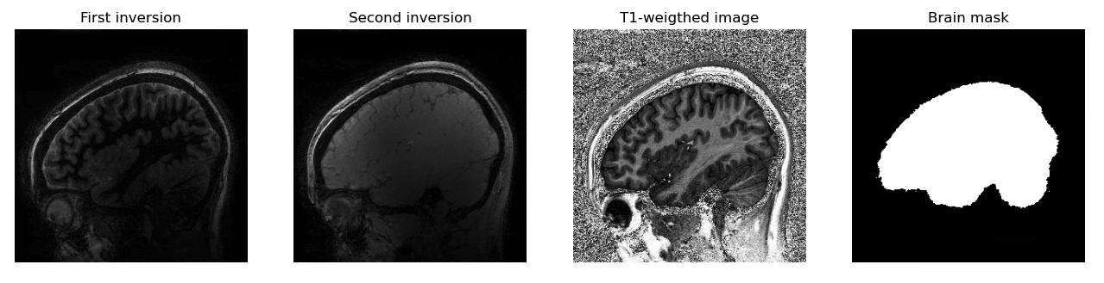
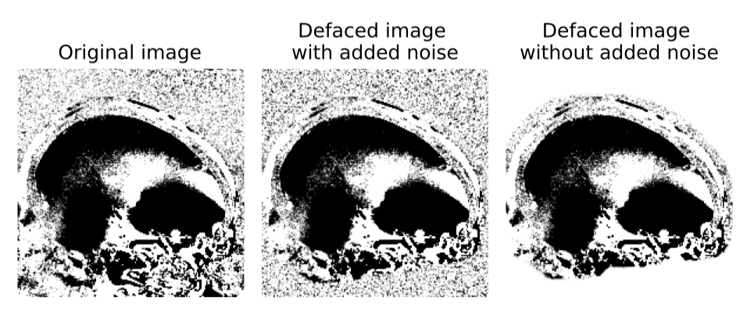
Results: Addition of Gaussian noise
A very small boundary is visible, but is negligible

